Slide 1

VISHWACON 2023

Slide 2
LITERATURE SURVEY : SENTIMENT ANALYSIS OF TEXT DOCUMENTS
Ashlesha Ahirwadi* ¹ ,Isha Shetye ² , Dr. Anagha Kulkarni ³
^{1,2,3}Department of Information Technology, Cummins College Of Engineering For Women, Pune, Maharashtra India – 411052

Slide 3
TABLE OF CONTENTS:
Abstract
Introduction
Literature review
Discussion
Research gap
Conclusion & Future Work
Reference

Slide 4
2. ABSTRACT
Internet aids connectivity
Personal devices help create exponential amount of data
Difficulty in analysis
Sentiment analysis - A solution
Data to knowledge
Machine learning algorithm comparison & evaluation

Slide 5
3. INTRODUCTION:
Digital content heavy on opinion
Sentiment analysis help extract opinion
Data categorized - 1. Based on polarity (positive, negative and neutral)
2. Based on emotions (sad, happy, angry..)
3. Based on range (Star rating)
Machine learning algorithms facilitate sentiment analysis

Slide 6
4. LITERATURE REVIEW :
Papers | Objective | Methods | Key Findings
1 | To analyse and recommend movies based reviews | Support Vector Machine, Naive Bayes | Support Vector Machine outperforms Naive Bayes by small margin
2 | To analyse sentiments related to URI attack using twitter data | Polarity classification, Emotion analysis | Fear and negative sentiments concentrated data
3 | Compare performance of machine learning algorithms for sentiment analysis | Naive Bayes, Random Forest, Support Vector Machine | Support Vector Machine out stood with high accuracy

Slide 7
4. LITERATURE REVIEW :
Papers | Objective | Methods | Key Findings
4 | Comparative study of different approaches | Machine Learning approach, Rule-based approach, lexical based approach | Machine Learning approach yields best results
5 | Sentimental Analysis of Twitter Data with respect to General Elections in India | Emotion analysis, Support Vector Machine | Considering sentiment parameters candidate 1 was found to be more loved
6 | Comparing multinomial and bernoulli Naive Bayes | Naive Bayes, Multinomial Naive Bayes, Bernoulli Naive Bayes | Multinomial works best with large size vocabulary unlike bernoulli Naive Bayes

Slide 8
4. LITERATURE REVIEW :
Papers | Objective | Methods | Key Findings
7 | Classification of tweets regarding COVID | Polarity classification, Data pre processing | Neural sentiment outweighs positive and non positive sentiment
8 | Preparation of data before analysis | Pre-processing techniques | Standardise data and reduced noise before training model

Slide 9
5. RESEARCH GAPS :
Biased dataset
Emoticon analysis
Multilingual data

Slide 10
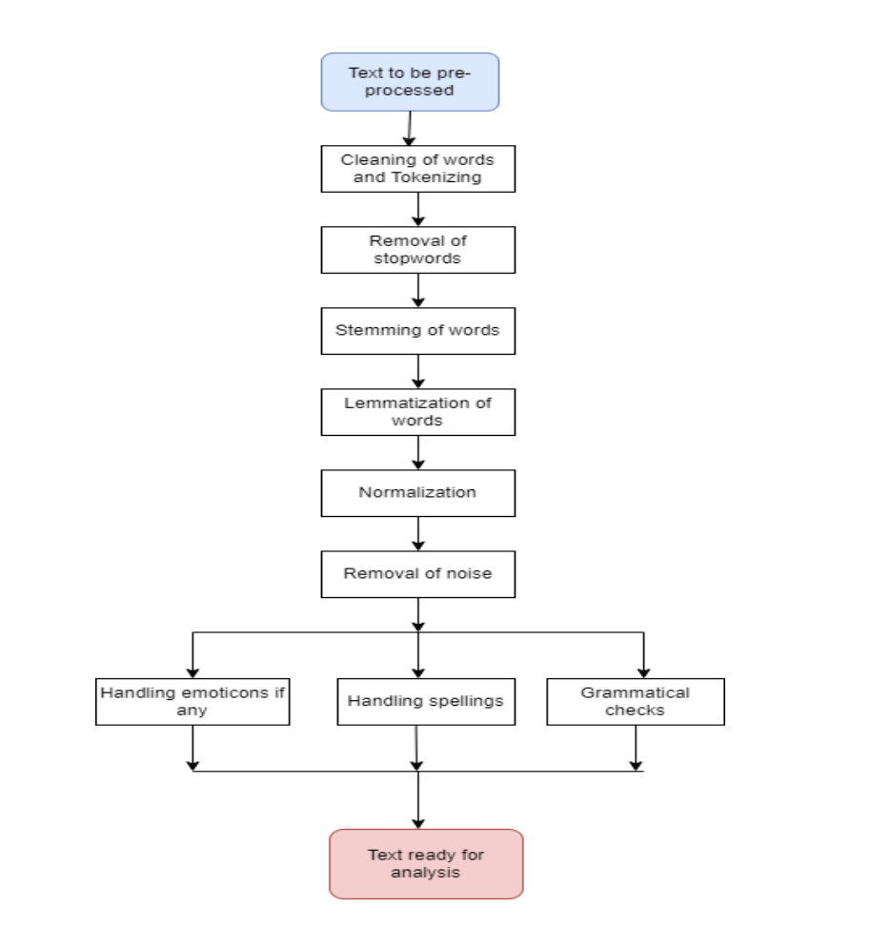
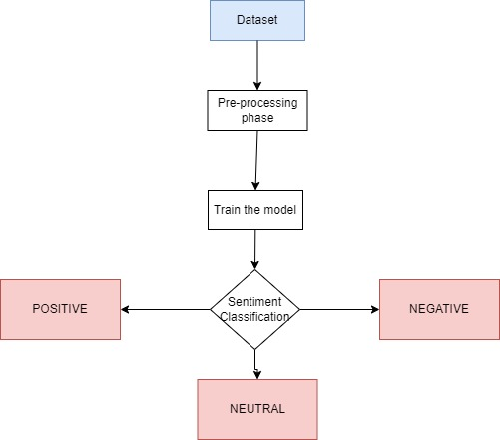
6. DISCUSSION:

Slide 11
7. CONCLUSION & FUTURE WORK :
Bridges gap between human and computers
Sentiment Analysis surpasses human computing capacity
Extract more than just polarity
Use in application concerning mental health
Sentiment Analysis model using multilingual approach

Slide 12
References :
1. A. Vijayaraj, K. Bhavana, S. SreeDurga, S. Lokesh Naik, “Twitter based sentiment analysis of Covid-19 observations”, Materials Today : Proceedings, vol 64, 2022, 713-719.
2. Deepak Kawade, “Sentiment Analysis: Machine Learning Approach”, International Journal of Engineering and Technology, vol 9(3), 2017, 0975-4024.
3. Ruby Prabowo, Mike Thelwell, “Sentiment Analysis: A Combined Approach”, Journal of Informetrics, Elsevier, vol. 3(2), 143-157, 2009.
4. Palak Baid, Apoorva Gupta, Neelam Chaplot, “Sentiment Analysis of Movie Reviews using Machine Learning Techniques”, International Journal of Computer Applications, vol 179(7),2023, 45-49.
5. Yelena Mejova, “Sentimental Analysis : An Overview”, Survey Paper, University of Iowa, 2009.

Slide 13
References :
6. Fatma Jemai, Mohamed Hayouni, Sahbi Baccar, “ Sentiment Analysis Using Machine Learning Algorithms”, International Wireless Communication and Mobile Computing, 2021.
7. P. Vijayaragavan, R. Ponnusamy, M. Aramudhan, “An optimal support vector machine based classification model for sentiment analysis of online product review”, Future Generation Computer Systems, vol 111, 2020, 234-240.
8. N Pavitha, Vithika Pungliya, Ankur Raut, Roshita Bhonsle, Atharva Purohit,Aayushi Patel, R Shashidhar, “Movie recommendation and sentiment analysis using machine learning”, Global Transitions Proceedings, vol 3, 2022, 279-284.
9. R Vidhya, Pavithra Gopalakrishnan, Nanda Kishore Vallamkondu, “Sentiment Analysis Using Machine Learning Classifiers: Evaluation of Performance”, Proceedings of the First International Conference on Computing, Communication and Control System, 2021.
10. Devika M D, Sunitha C, Amal Ganesh, “Sentiment Analysis: A comparative Study On Different Approaches”, Procedia Computer Science, vol 87, 44-49, 2016.

Slide 14
References :
11. Ankita Sharma, Udayan Ghose, “Sentimental Analysis of Twitter Data with respect to General Elections in India”, Procedia Computer Science, vol 173, 2020, 325-334.
12. Sunil Malviya, Arvind Kumar Tiwari, Rajeev Srivastava, Vipin Tiwari, “Machine learning techniques for sentiment analysis : A review”, SAMRIDDHI, vol 12(2), 2020.
13. Niklas Braig, Alina Benz, Soeren Voth, Johannes Breitenbach, Ricardo Buettner, “ Machine learning Techniques for Sentiment Analysis of COVID-19 Related Twitter Data”, IEEE Access, vol 11, 14778-14803, 2023.
14. SoYeop Yoo, Jeln Song, OkRan Jeong, “Social media contents based sentiment analysis and prediction system”, Expert System With Applications, vol 105, 2018, 102-111

